Slide 1
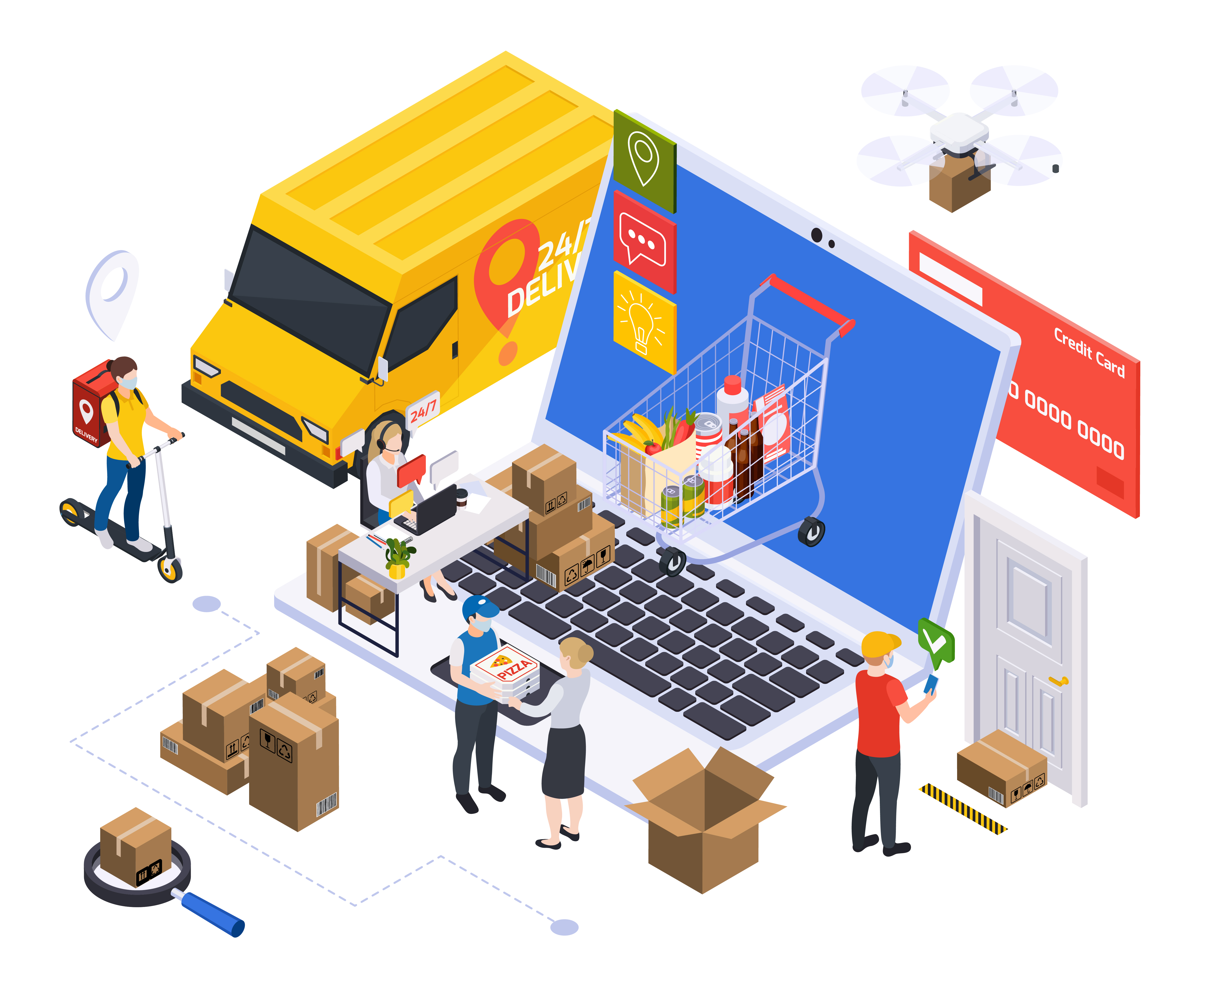
Smart Order & Inventory Management System
A Full-Stack Enterprise Web Application for order processing, Inventory tracking & Billing automation.
Developed by
SnehaLatha Avala

Slide 2
Project Overview
The objective of this project is to build a secure, scalable, role-based enterprise application that automates order management, inventory tracking, billing, and reporting for a retail and distribution organization.
Allows users to place and manage orders.
Tracks inventory across warehouses.
Automatically generates invoices.
Provides dashboards and analytical reports.
Ensures secure access using role-based authorization.

Slide 3
Technology Stack
Backend
ASP.NET Core Web API (.NET 8)
Entity Framework Core
LINQ
JWT Authentication
SQL Server
Frontend
Angular (Latest)
TypeScript
Angular Material
Chart.js (Reports)
Tools
Postman
Swagger
GitHub

Slide 4
Existing Challenges
Mid-sized retail and distribution companies often rely on manual or disconnected systems, leading to:
Delayed order processing
Poor inventory visibility
Lack of coordination between sales, warehouse, and finance teams
No real-time business insights
Key Challenge :
Maintaining data consistency and security across multiple roles such as Sales, Warehouse, Finance, and Customers while supporting real-time updates.

Slide 5
Roles
Admin :
Manage users by doing CRUD operations
Assign roles to Users
Manage Products and categories by CRUD operations
Sales Executive :
Warehouse Manager :
Create Orders for Customers
Track customer orders
Add stock to Products and mange stock
Order fulfillment ,can update order status
Finance Officer :
Customer :
Can view invoices
payment status
Can place orders
Track order status

Slide 6
Key features :
User registration & login
Role-Based Access Control (RBAC)
JWT-based authentication
Register and Login screens
User Management
Category & Product Management
Order Management
Order Processing Workflow
Inventory Management
Dashboards & Reports
Notifications System
Invoice and payments

Slide 7
User Management
Handles user registration, authentication, role assignment, and activation/deactivation using JWT and role-based access control.
Category & Product Management
Allows Admin to manage product categories and products, including price and availability, which are used during order creation and inventory tracking.
Order Management & Order Processing Workflow
Supports creation and tracking of orders with a defined lifecycle:
Created → Approved → Packed → Shipped → Delivered,
ensuring controlled order processing across roles.

Slide 8
Inventory Management
Tracks product stock at warehouse level, validates availability before order placement, and automatically updates stock during dispatch.
Dashboard & Reports
Provides role-specific dashboards and reports such as sales by date/product, inventory status, and top-selling products using aggregated data.
Notification System
Generates real-time notifications for order status updates and important events, ensuring timely communication to users.
Invoice & Payments
Generates real-time notifications for order status updates and Low stock alerts, ensuring timely communication to users.

Slide 9
Testing
Unit testing using xUnit
API testing using Postman
Authentication & authorization tests
Valid and invalid token scenarios
Role-based access testing

Slide 10
Database Schema Diagram

Slide 11
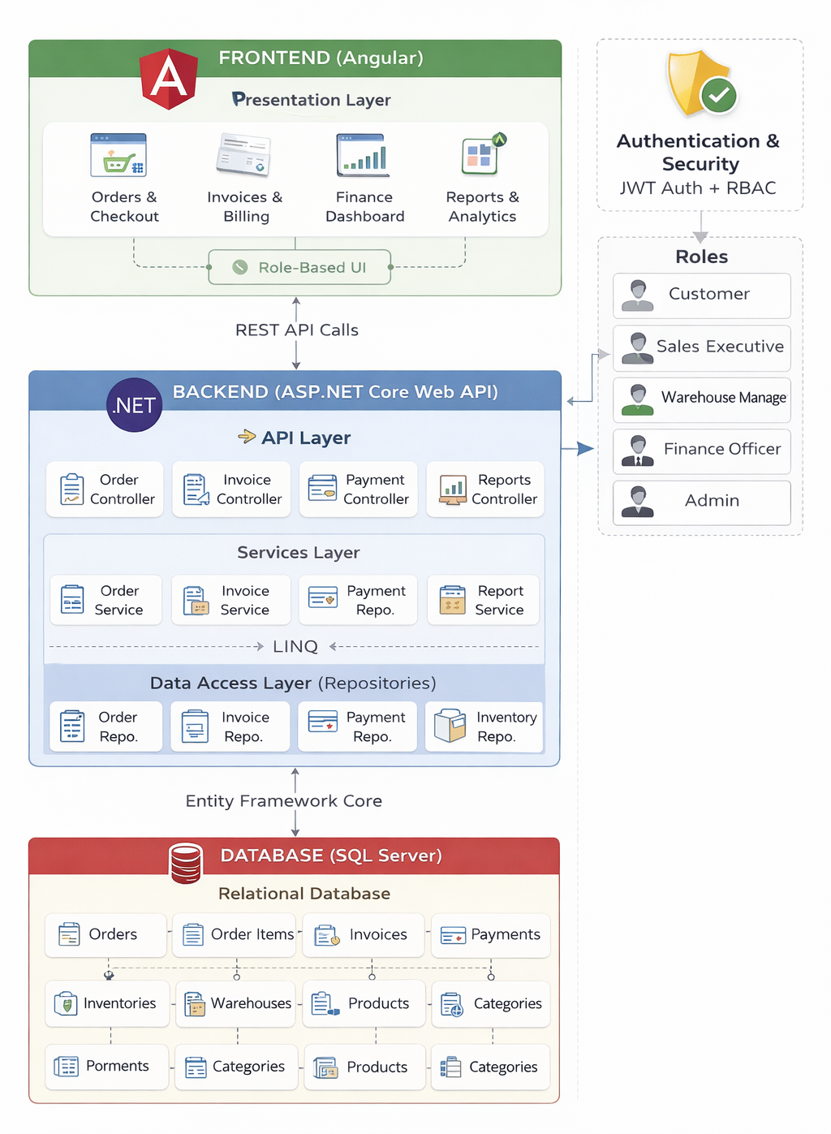
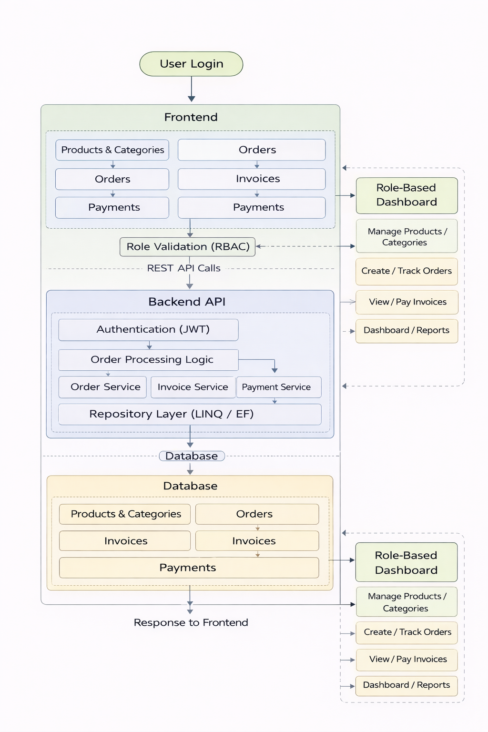
System Architecture

Slide 12
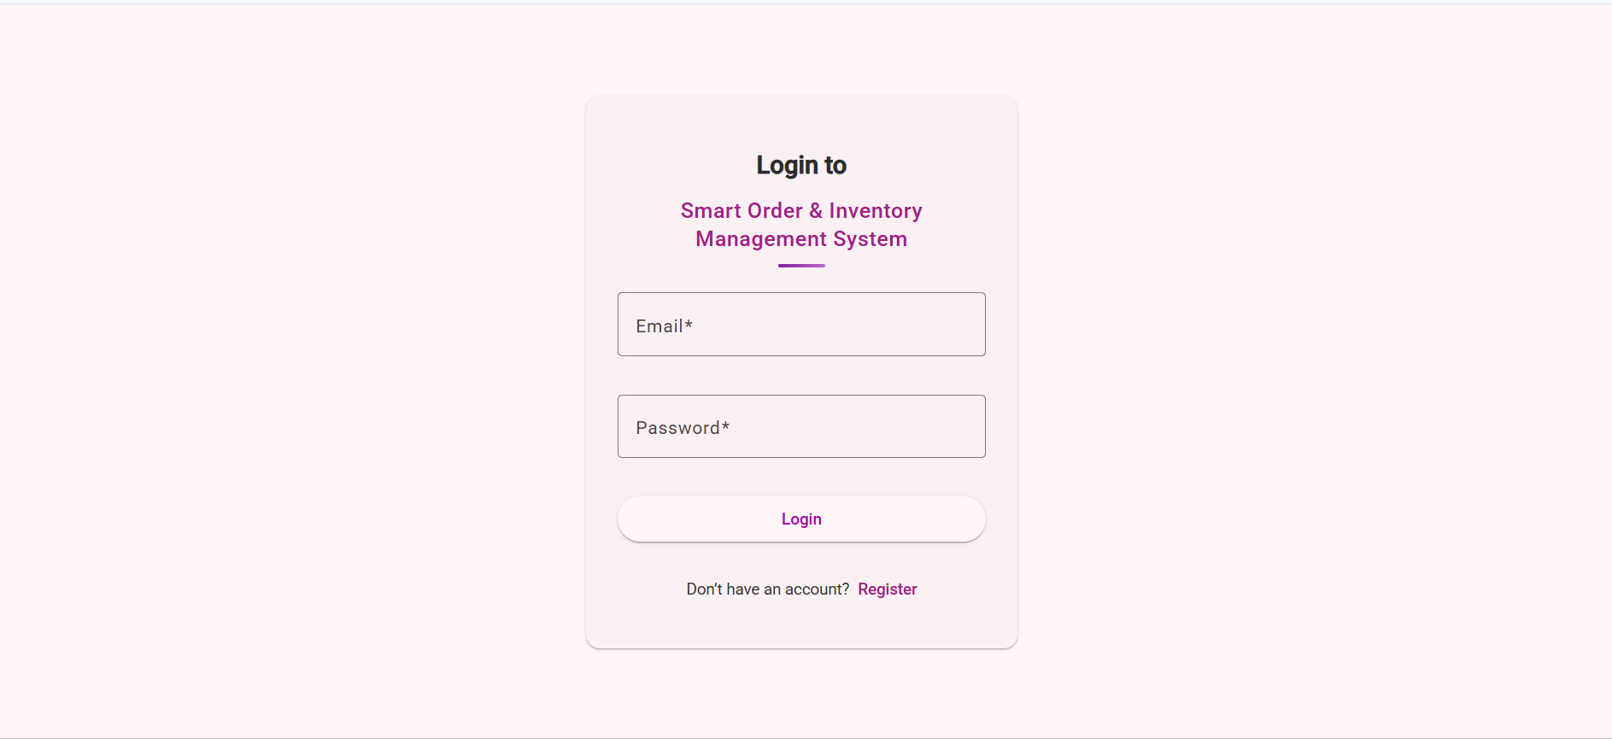
Login Screen

Slide 13
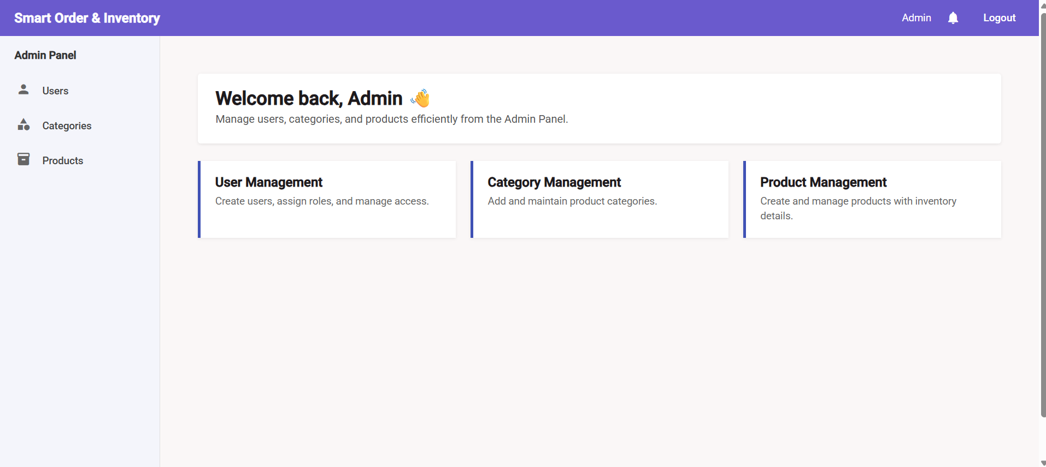
Admin Dashboard

Slide 14
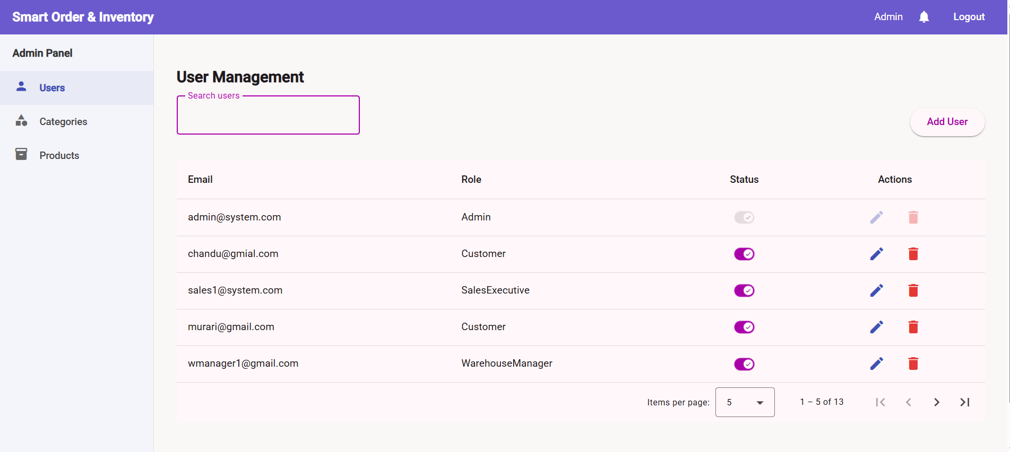
User Management screen

Slide 15
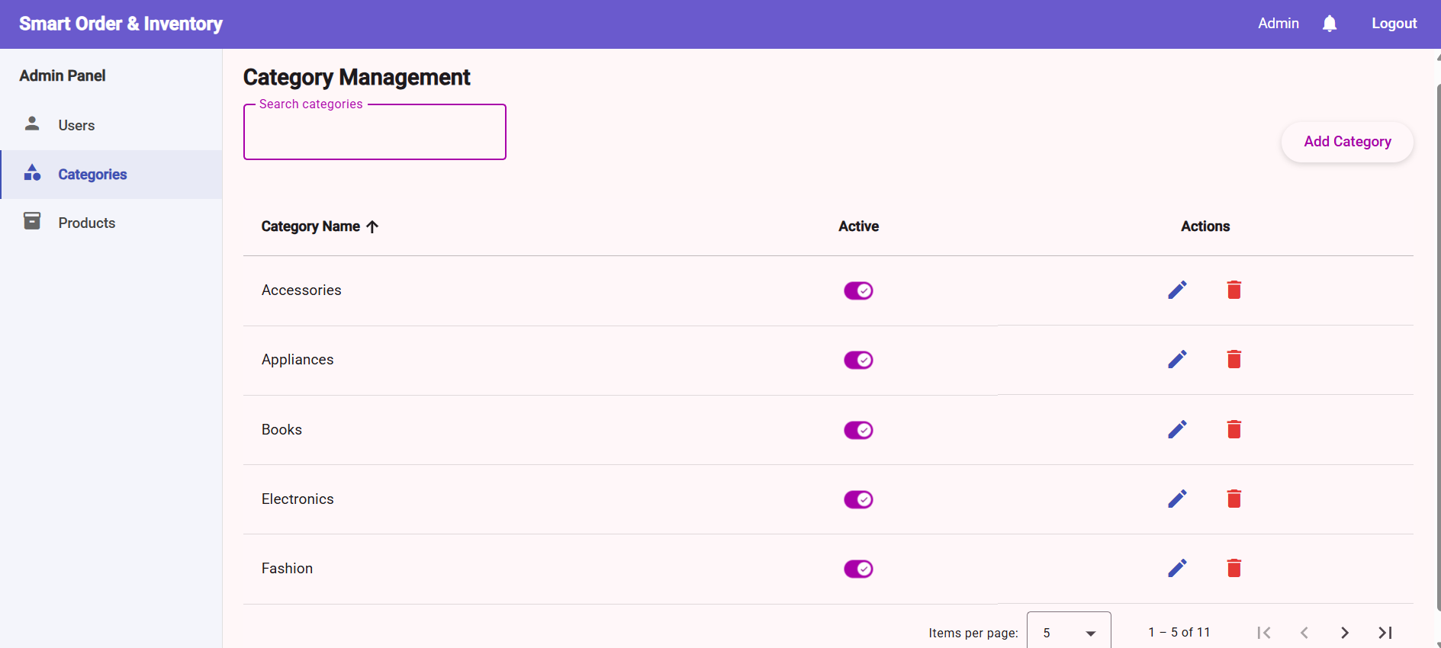
Categories Management Screen

Slide 16
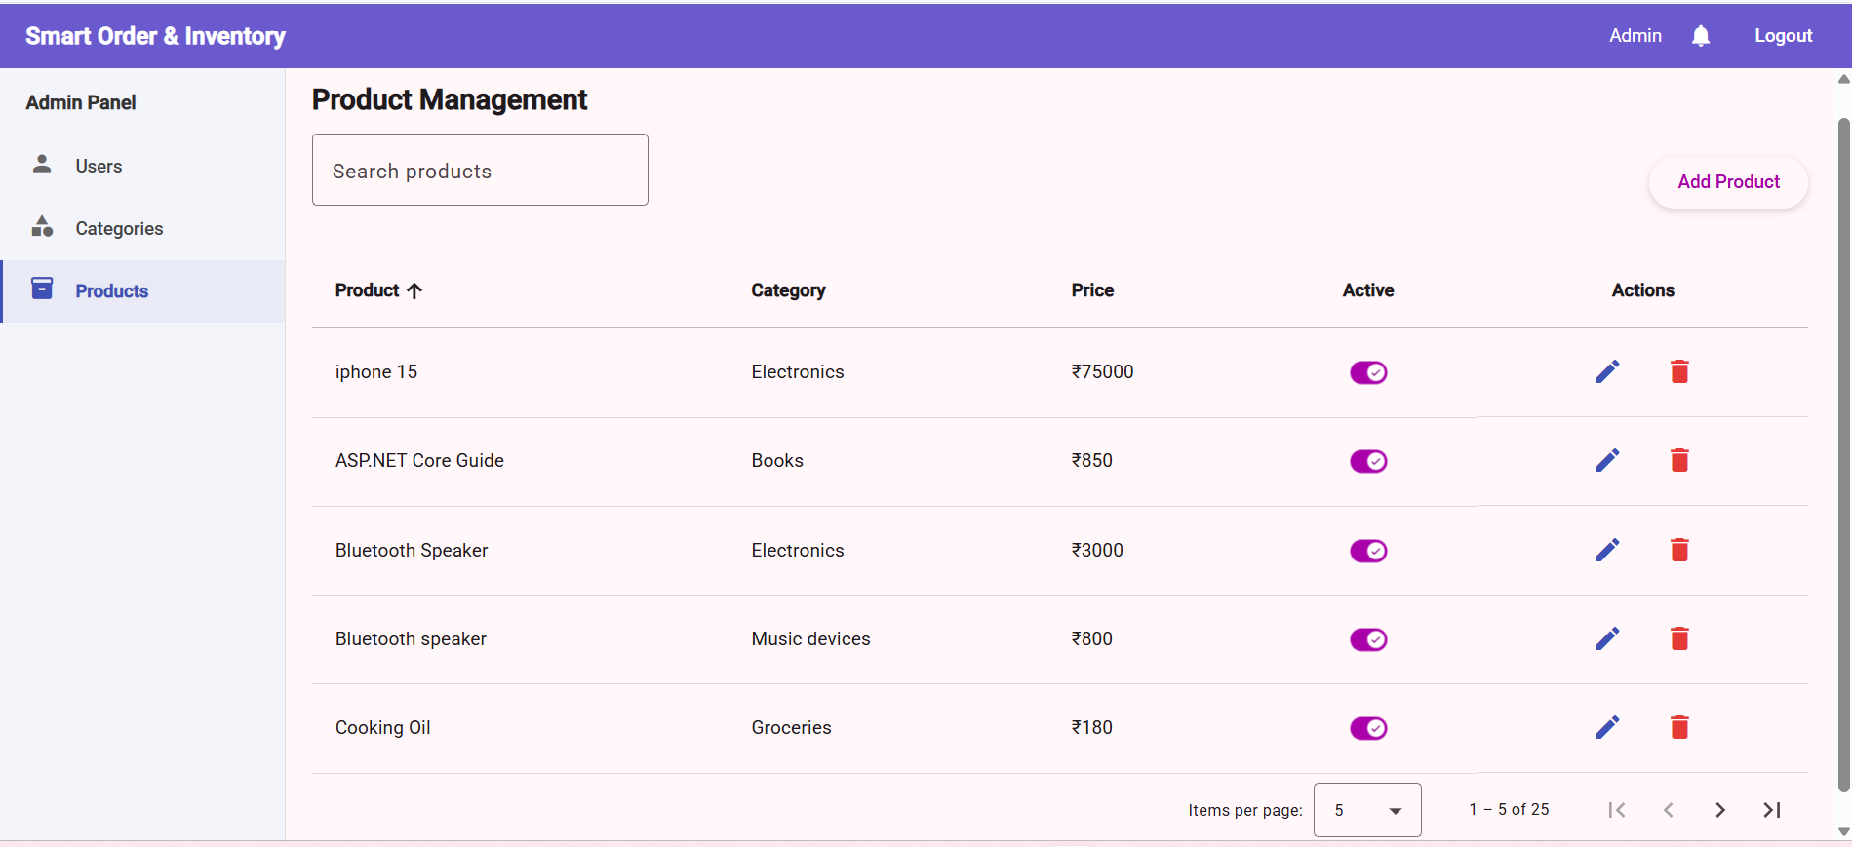
Products Management Screen

Slide 17
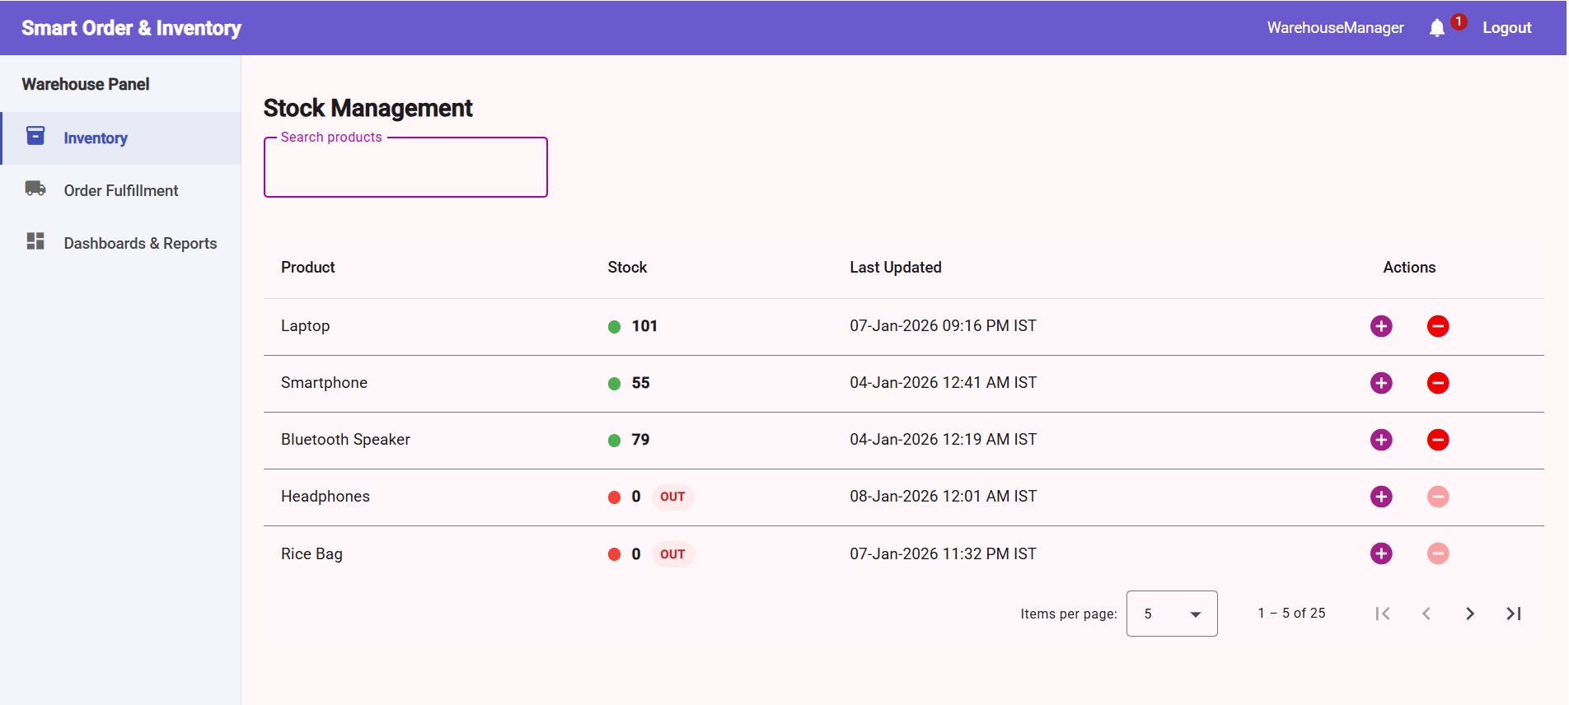
Inventory Management

Slide 18
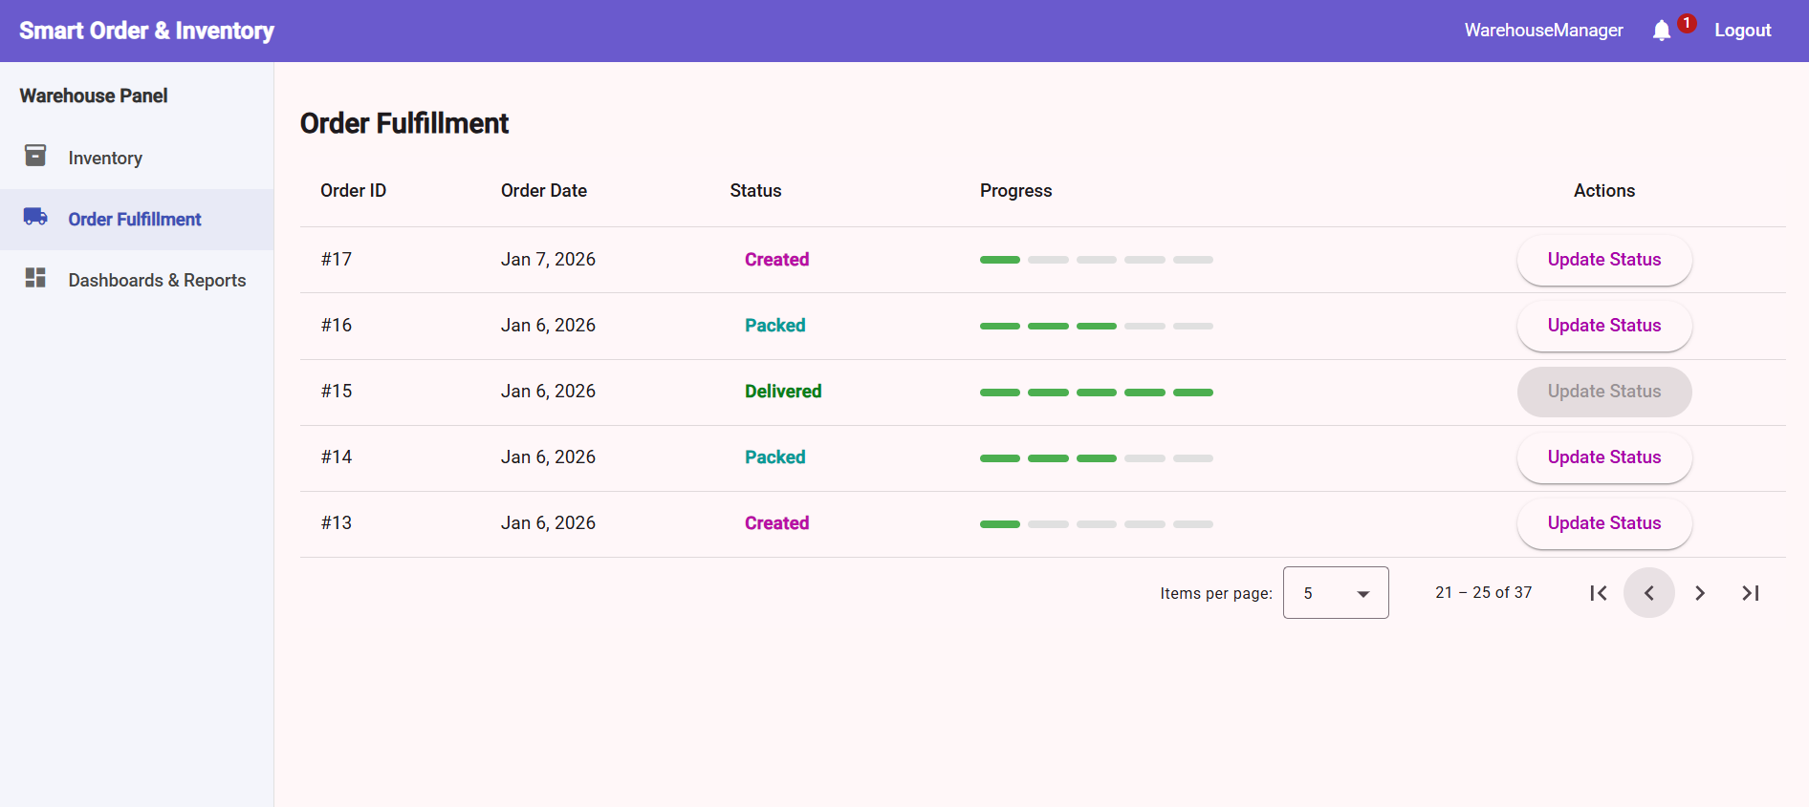
Order Fulfillment Screen

Slide 19
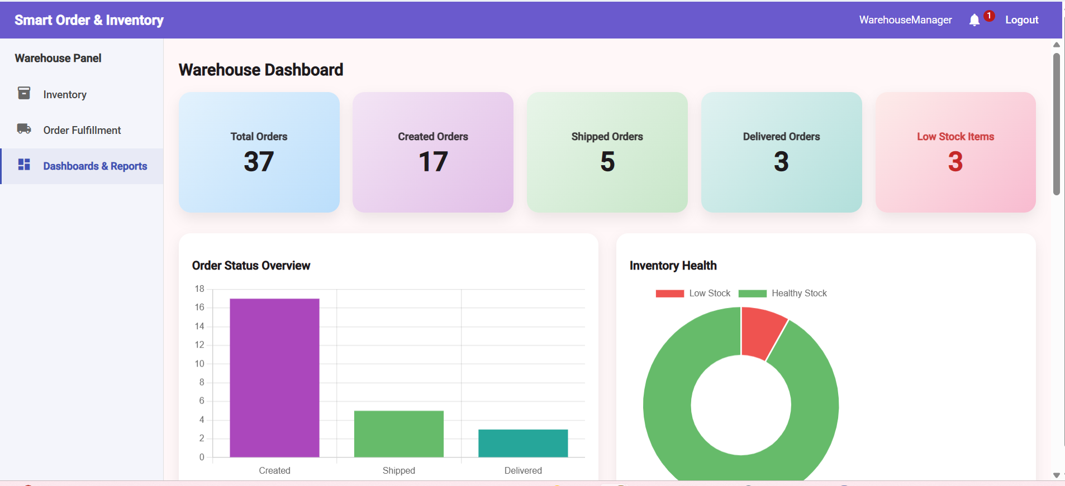
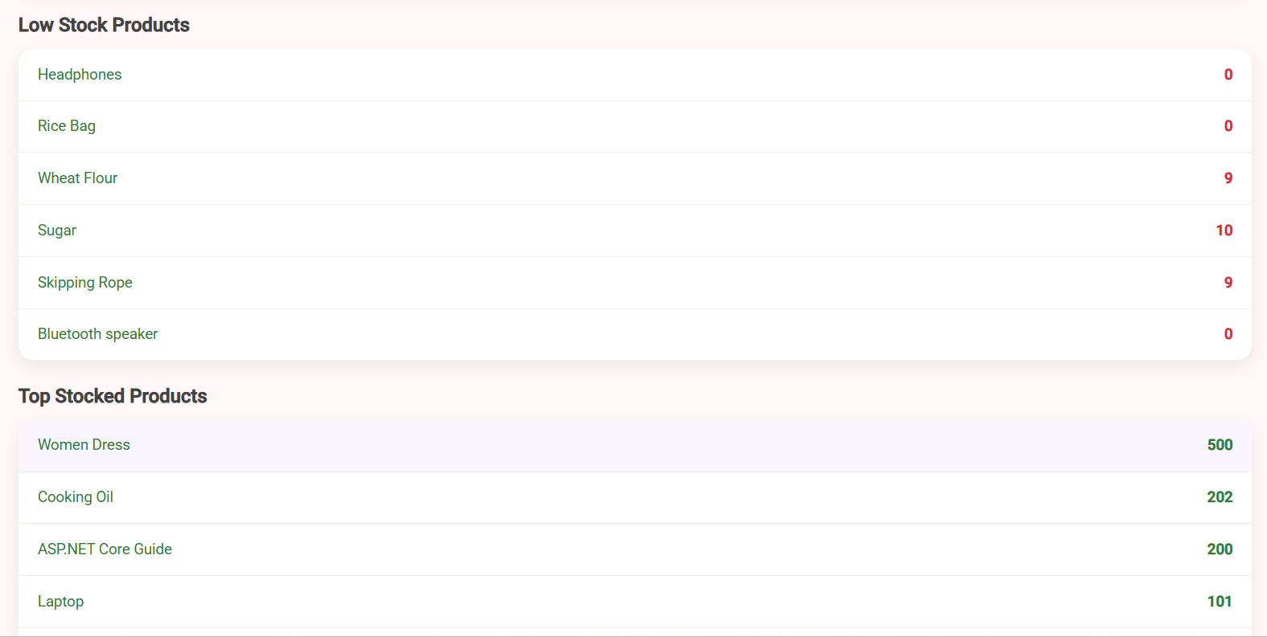
Inventory-status Reports

Slide 20
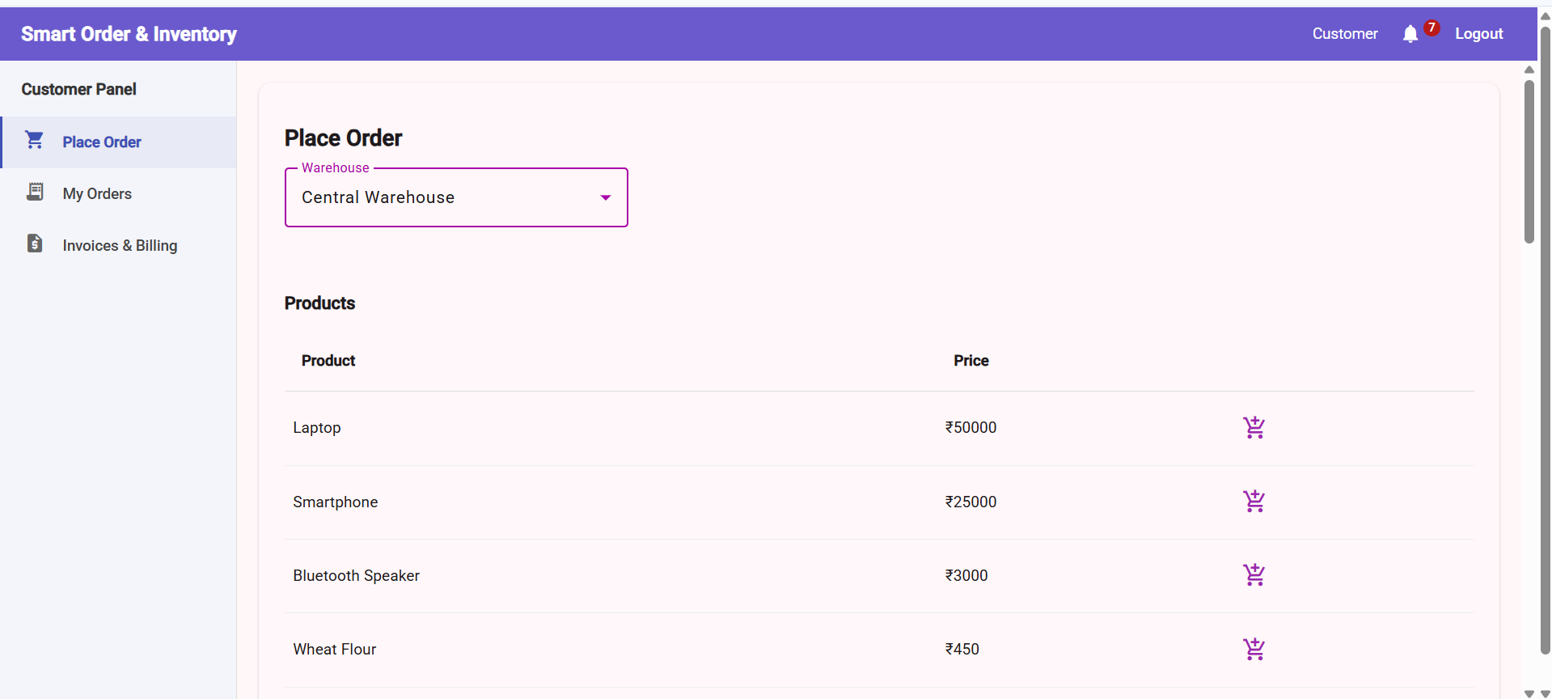
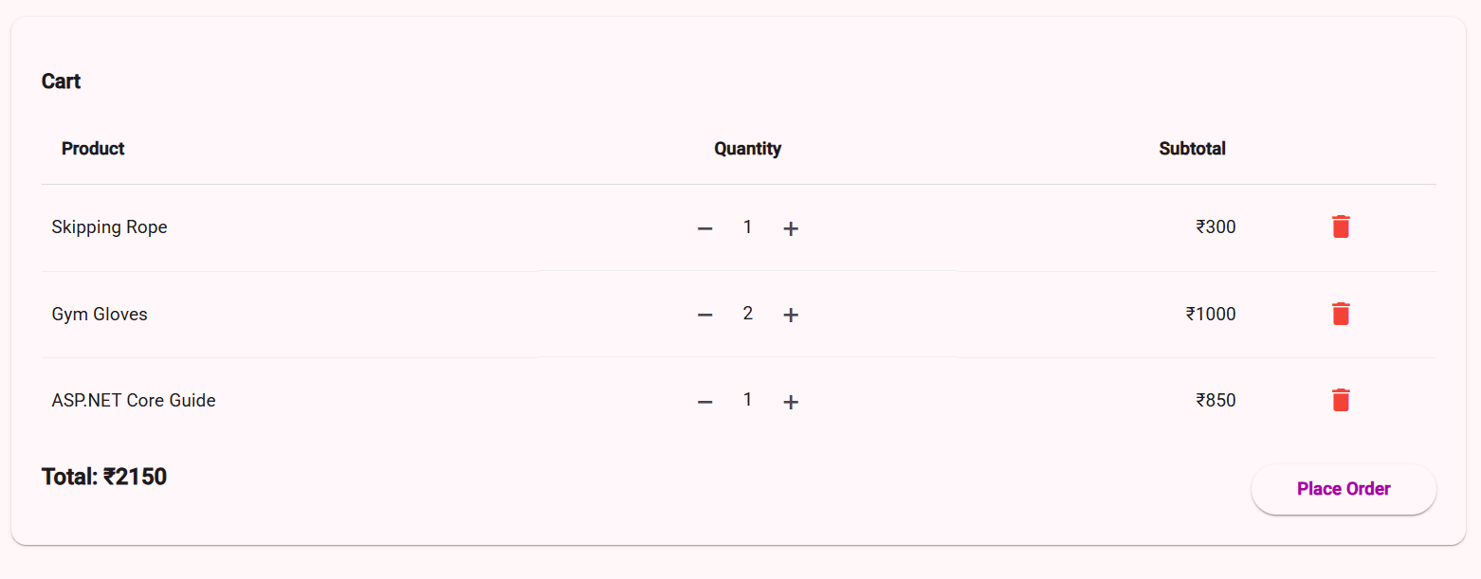
Customer Place Order Screen

Slide 21
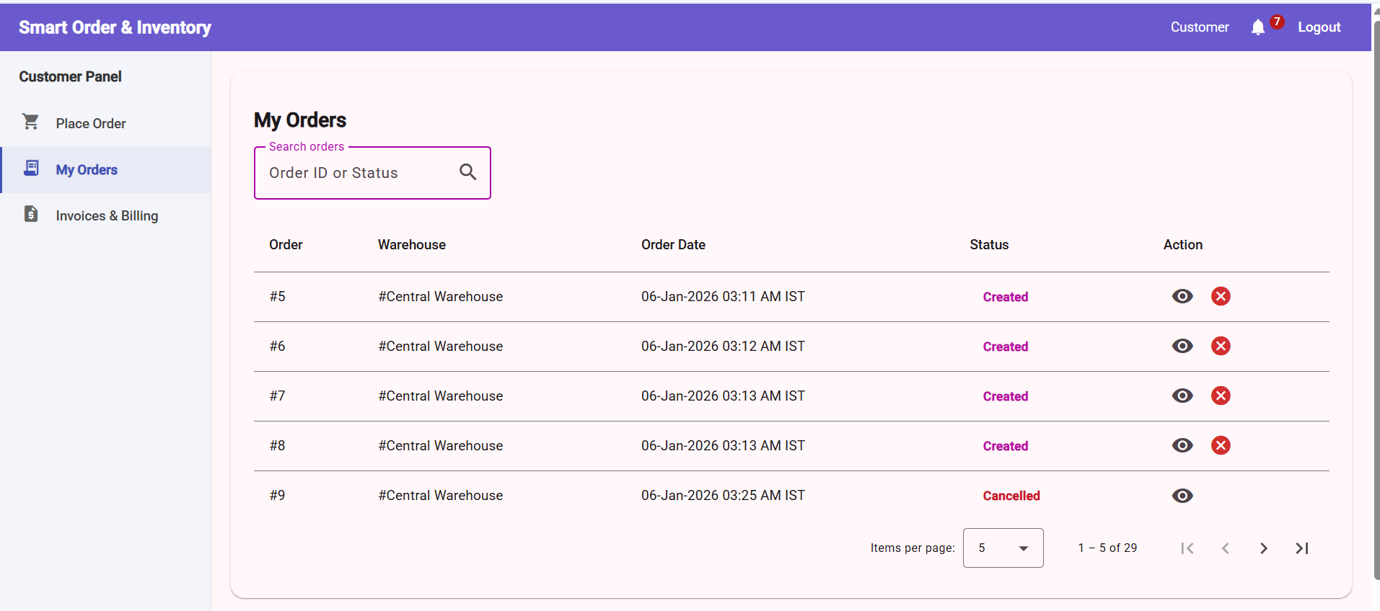
Customer‘s Order Screen

Slide 22
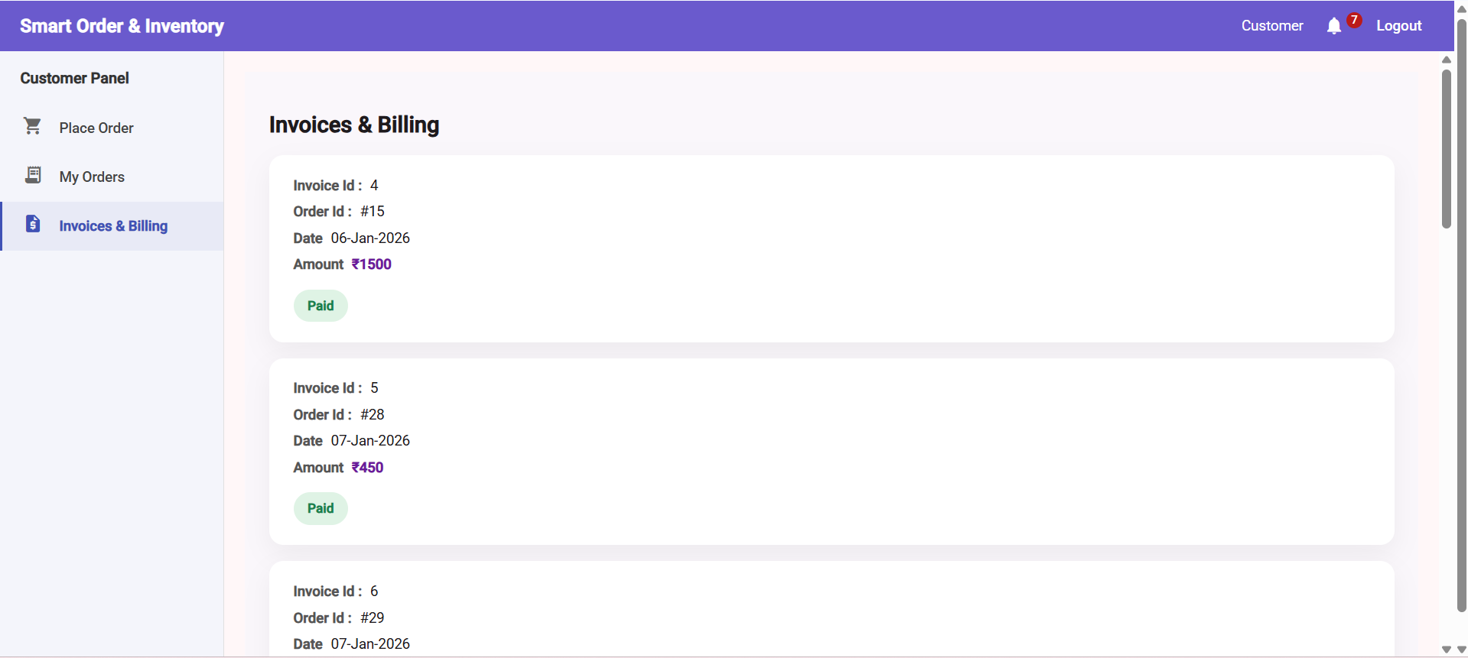
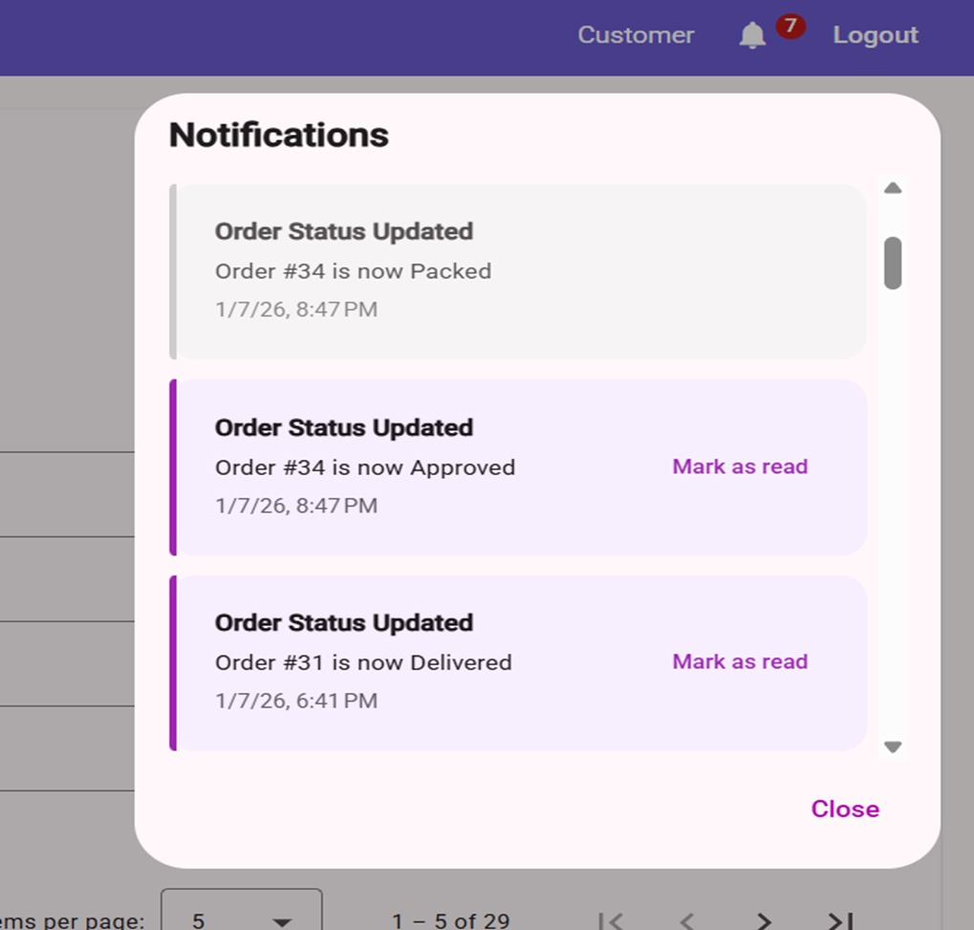
Invoices & Billing screen

Slide 23
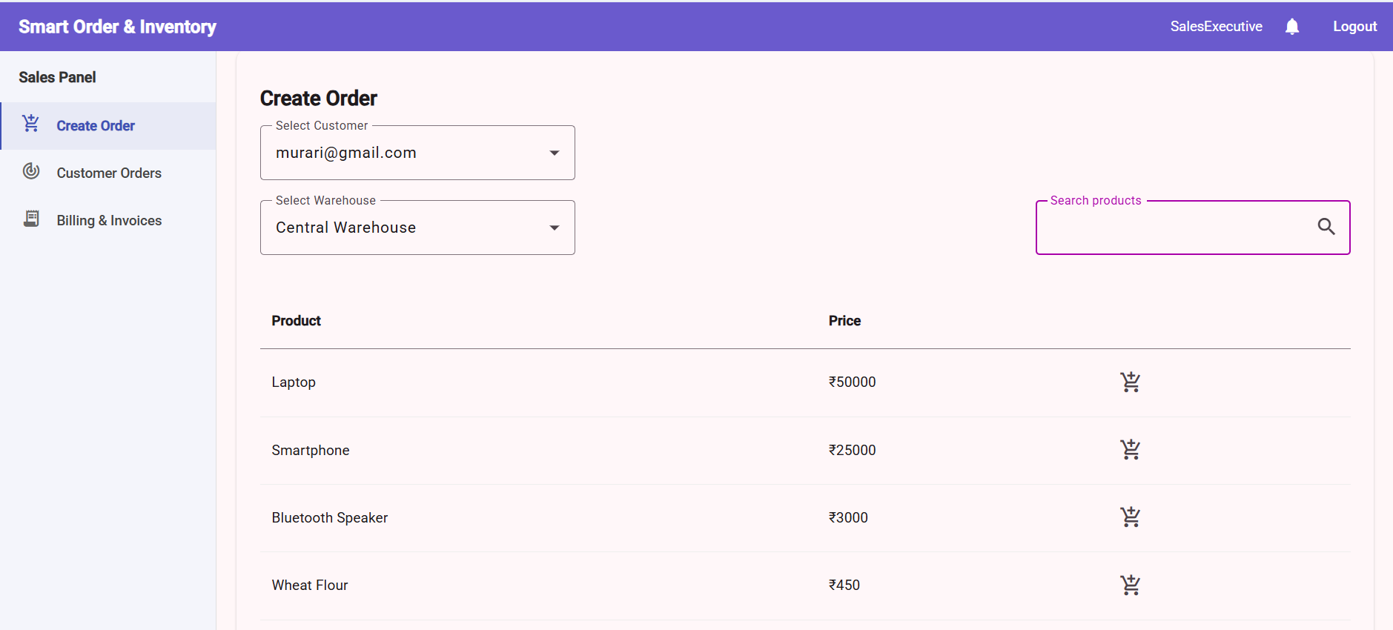
Sales Executive Screen

Slide 24
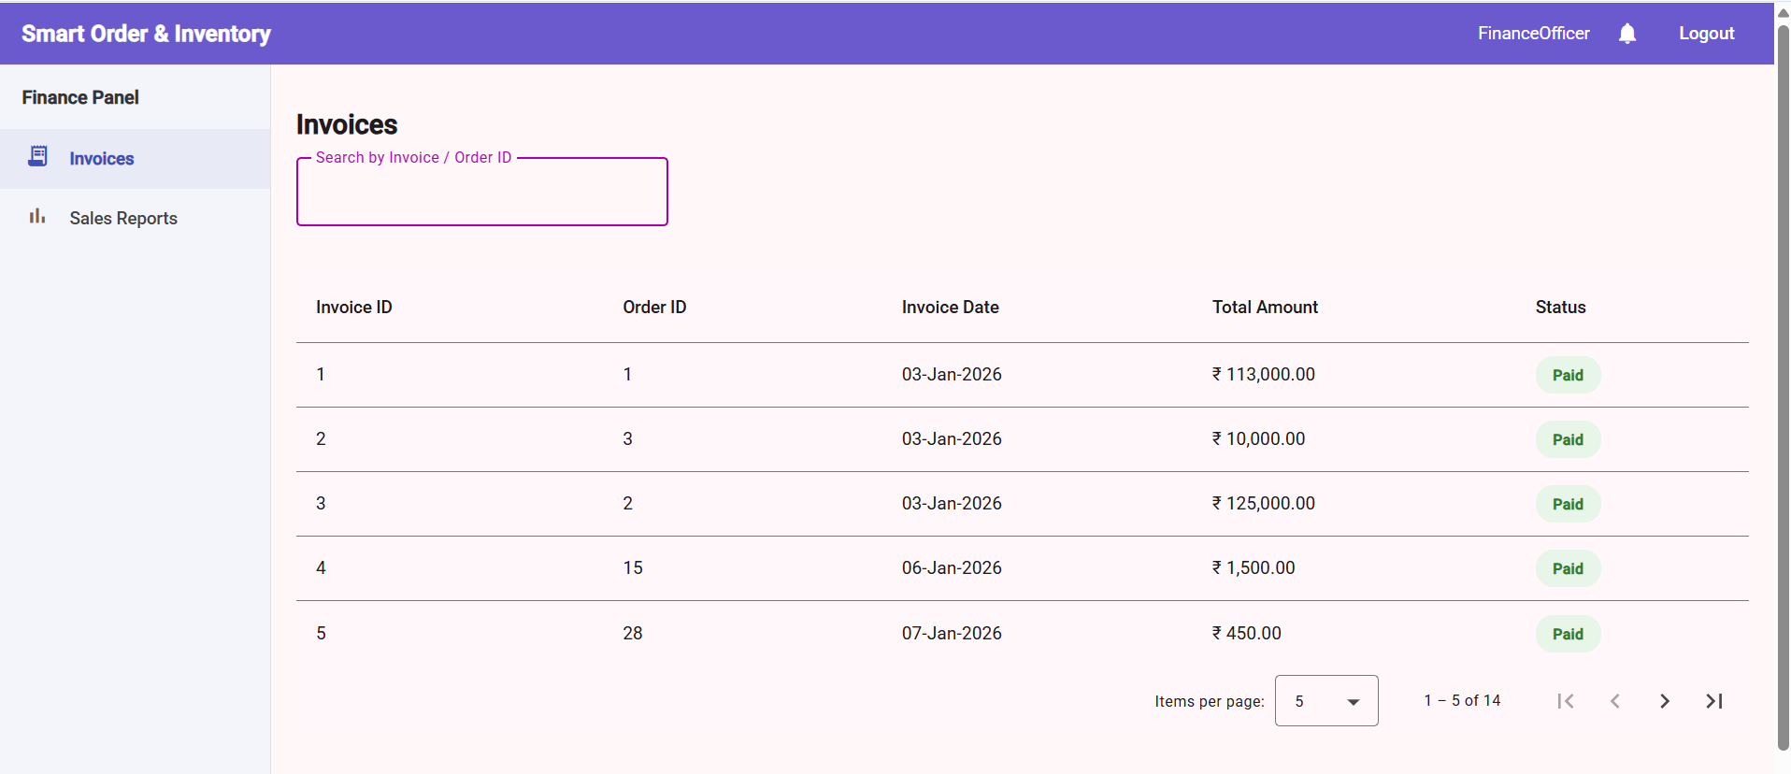
Finance Officer View Invoices

Slide 25
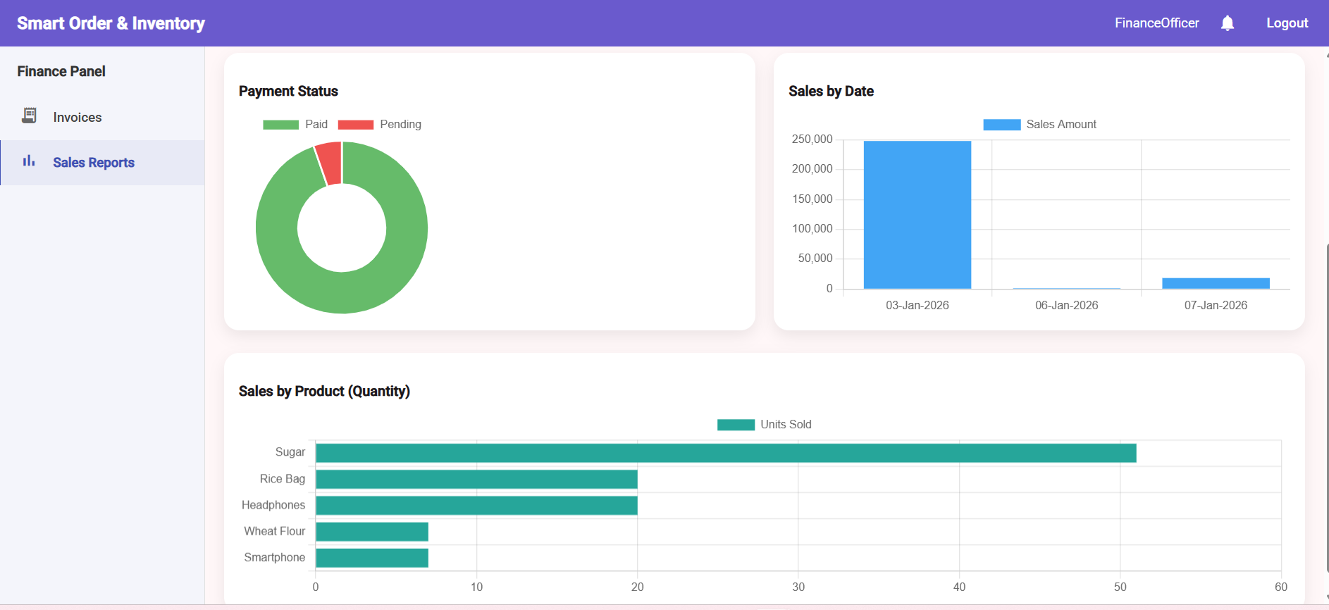
Sales Reports

Slide 26
Conclusion
Developed a secure and scalable Smart Order & Inventory System using ASP.NET Core Web API with JWT-based role authentication.
Implemented efficient management of users, warehouses, products, orders, invoices, and notifications with role-based access control.
Ensured reliability and code quality by implementing unit testing using xUnit .

Slide 27
Thank You

